Slide 1
Zenith Hackathon
TEAM NAME : C O D E 4 C E S
TEAM LEADER NAME: ARHI ARHA SUDHAN S
Project Name: NexusEdu
[Smart Academic & Opportunity Management Platform]
PROBLEM STATEMENT TITLE: UNIVERSITY ERP SYSTEM

Slide 2
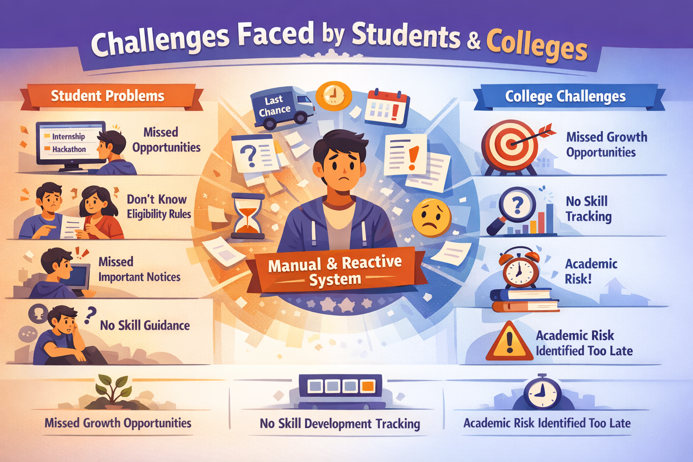
PROBLEM STATEMENT
Many colleges use ERP systems to manage attendance, marks, and notices.
But students still face problems:
They miss opportunities like internships
and hackathons.
They don’t know eligibility rules.
Important notices get lost.
No guidance based on student skills.
Everything is manual and reactive.
Because of this:
Students miss growth opportunities.
Colleges cannot track skill development.
Academic risk is identified too late.

Slide 3
The Solution – NexusEdu Orchestrator
Student-Centric Intelligent ERP
NexusEdu integrates academic records, institutional policies, student skills, and opportunities into a centralized platform.
Core System Capabilities
    Academic tracking & eligibility monitoring
    AI academic assistant
    Opportunity visibility & structured communication
    Achievement tracking & motivation support
    Faculty curriculum insights
    Inter-college collaboration
The system transforms ERP from passive record storage into an active academic guidance platform.

Slide 4
Work Flow
Structure
Step 1: College uploads data
    Attendance
    Marks
    Policies
Opportunities
Step 2: Data is stored securely in the system.
Step 3: AI analyzes the data.
Step 4: Students get:
Eligibility alerts
Opportunity recommendations
Academic warnings
Step 5: Admin monitors overall performance.
Layered Architecture Design
Role Layer: Students, Faculty, Admins, Super Admin
Frontend: Web dashboards for all stakeholders
Backend: API orchestration & business logic
AI Layer: Academic assistant & predictive modules
Database: Academic, policy, and opportunity datasets
Technology Stack
React + Tailwind (Frontend)
FastAPI (Backend)
PostgreSQL + Redis (Database & caching)
Gemini API (AI processing)
Docker + Cloud hosting (Deployment)
This ensures scalability, modularity, and multi-institution readiness.

Slide 5
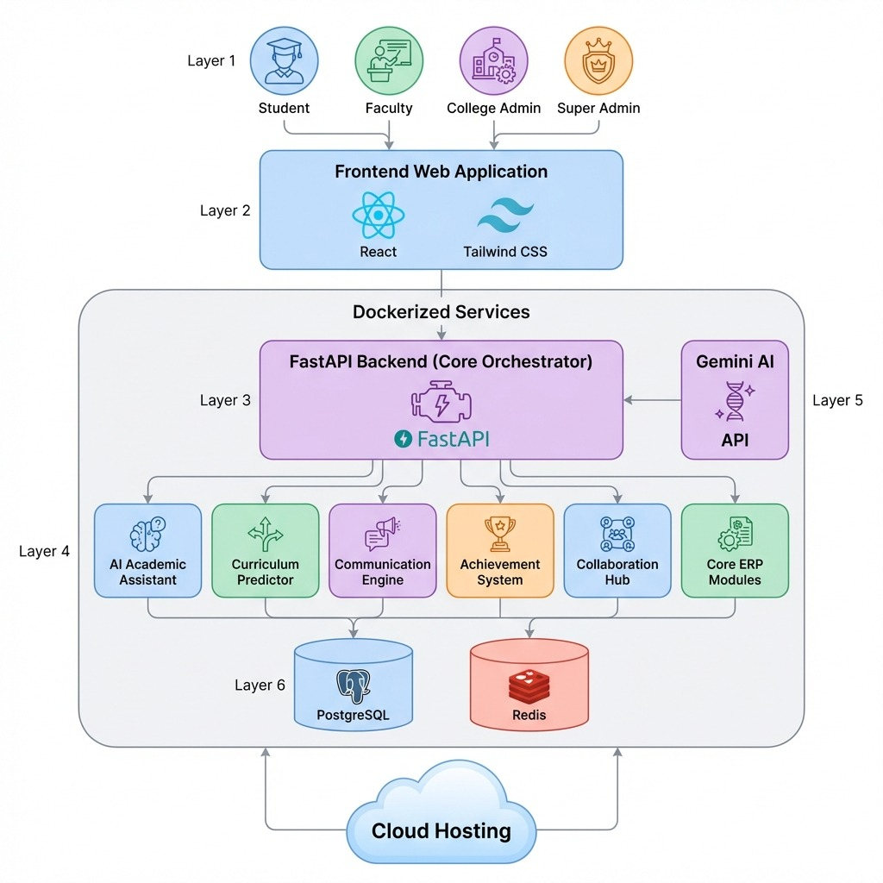
ARCHITECTURE

Slide 6
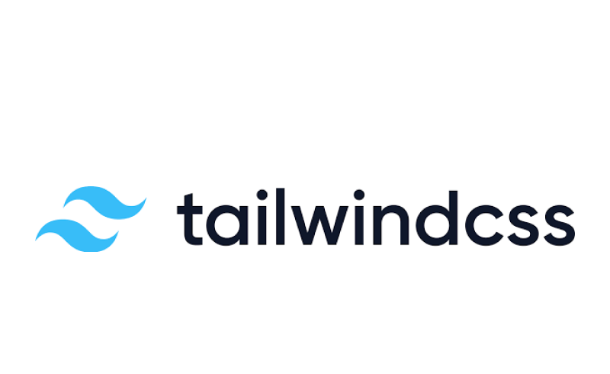




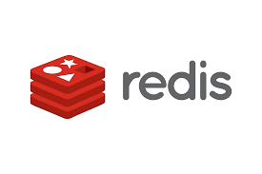
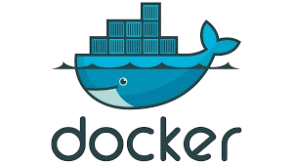
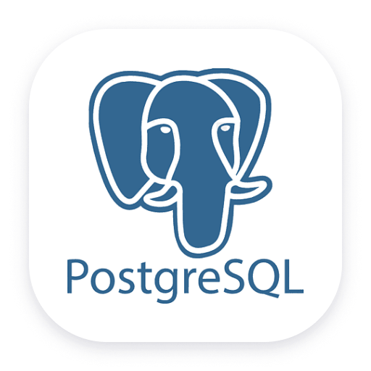
TECH STACK
Tech Stack

Slide 7
The NexusEdu Edge – Engineering Innovation
AI Academic Assistant
Interactive chatbot that answers queries on attendance, eligibility, and performance while guiding study improvement.
Curriculum Predictor
Analyzes academic trends to support faculty in data-driven course planning.
Achievement & Motivation System
Tracks accomplishments, sends reminders, and recommends relevant competitions.
Opportunity-Aware Communication Feed (Key Innovation)
Structures internships, hackathons, and scholarships into a dedicated ERP feed instead of emails. Ensures visibility, eligibility filtering, and engagement tracking.
Inter-College Collaboration Hub
Admin-controlled platform enabling cross-college projects and academic partnerships.

Slide 8
Delivering Measurable Institutional Impact
1.Rapid Deployment: Our "One-Click Onboarding" removes technical barriers, allowing a university to go fully operational in under 10 minutes with zero local server costs.
The Sharing Economy: AI-powered inter-college exchanges reduce infrastructure duplication, allowing institutions to share high-cost lab equipment and faculty expertise, cutting overhead by up to 30%.
2. Student Success: The "Zero-Surprise" Policy
Predictive Retention: Real-time eligibility tracking and AI study plans eliminate "exam-day disqualification" and improve overall learning outcomes by identifying student struggles early.
Career Catalyst: By filtering and pinning life-changing hackathons and internships, we ensure a 100% visibility rate for growth opportunities that students previously missed.

Slide 9
Delivering Measurable Institutional Impact
3. Administrative Excellence: Automated Governance
Faculty Empowerment: By automating routine monitoring and early-risk alerts, we reduce administrative load, allowing faculty to focus on mentorship rather than paperwork.
Audit-Ready Governance: Centralized, immutable records of attendance and performance provide a "Single Source of Truth," making accreditation and compliance reporting seamless and error-free.
4. Future-Proof Scalability
Secure Growth: Our Multi-tenant architecture isn't just a database; it’s a SaaS Framework. It is built to scale from one department to an entire national university network without compromising speed or security.

